Slide 1


Chaos, Predictability, and
Data Assimilation
February 8, 2013, AICS Cafe
Takemasa Miyoshi
Data Assimilation Research Team
Takemasa.Miyoshi@riken.jp
With many thanks to
Data Assimilation Research Team,
E. Kalnay, K. Ide, B. Hunt, S. Greybush, S. Penny, G.-Y. Lien,
UMD Weather-Chaos group, Y. Ota (NCEP/EMC, JMA),
S.-C. Yang (Taiwan), J.-S. Kang (Korea),
M. Kunii, T. Enomoto, and N. Komori (Japan)

Slide 2

Who am I?

Slide 3
Dynamical simulations
Model = time-advancing operator
Simulation = state evolution
time

Slide 4
Let’s think about predictions.
What kind of forecast is reliable?
  Thunderstorm
  Seasonal forecast (warm summer this year?)
  Ocean tide
  Solar eclipse
  Stock price
  Who you will marry
What characterizes the reliability of forecast?

Slide 5
Sensitivity to initial conditions
Perturb the initial conditions and run the multiple forecasts (a.k.a. ensemble forecasts)
P
P
Less certain
More certain
T=t0
T=t1
T=t0
T=t1

Slide 6
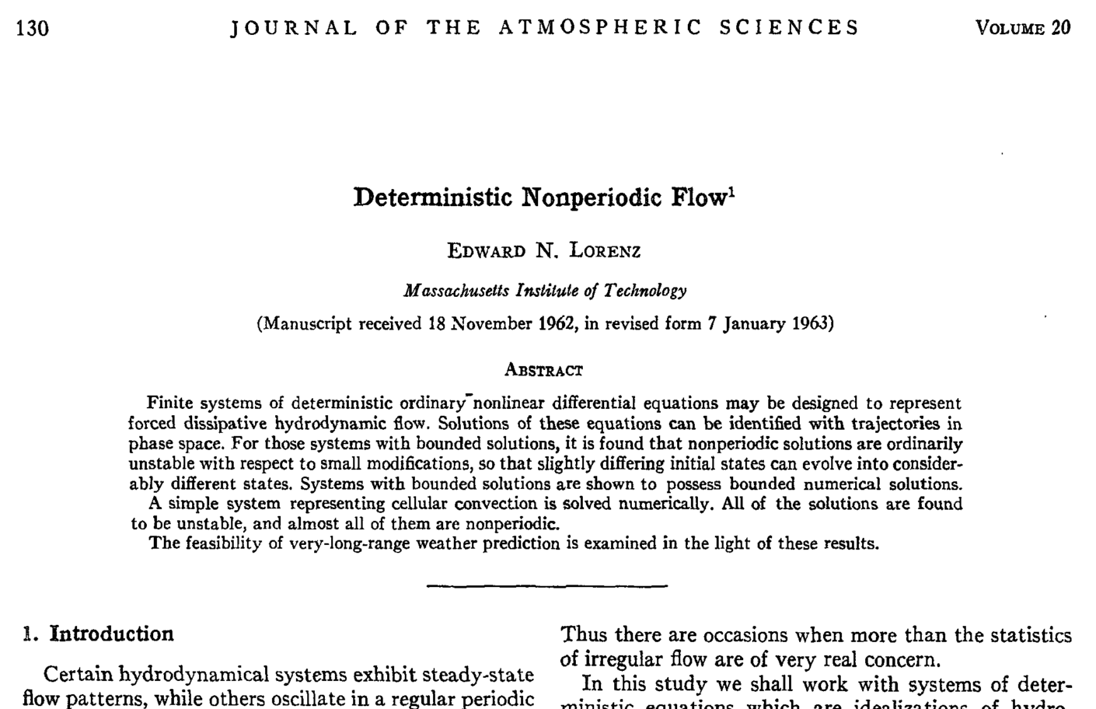

Slide 7

Deterministic chaos
= sensitivity to the initial conditions
Model solutions in phase space
Uncertain initial states
Local instabilities
Diverging predictions

Slide 8
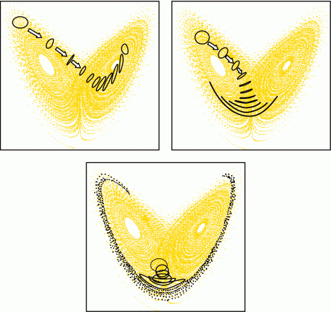
Predictability is about uncertainties.
More predictable
Less predictable
Very unpredictable

Slide 9
Predictability is about uncertainties.
More predictable
Less predictable
We have uncertain initial estimates,
and uncertain predictions.
Very unpredictable

Slide 10
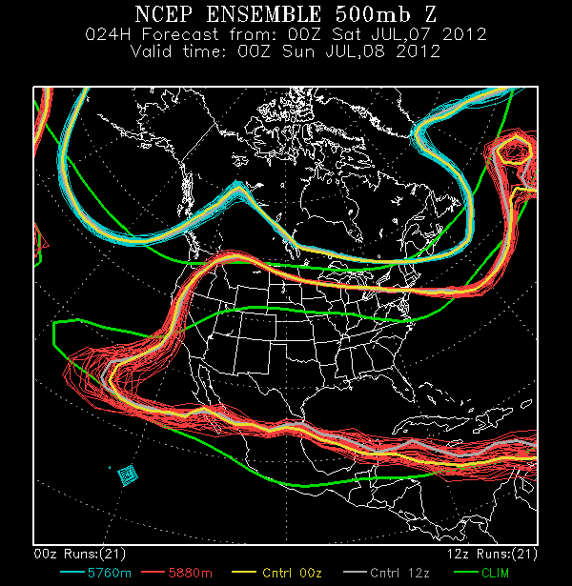
Weather system is chaotic.
Chaotic dynamical system has intrinsic limit to predictability.

Slide 11
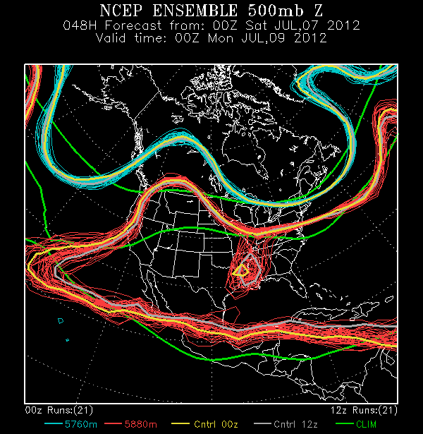
Weather system is chaotic.
Chaotic dynamical system has intrinsic limit to predictability.

Slide 12
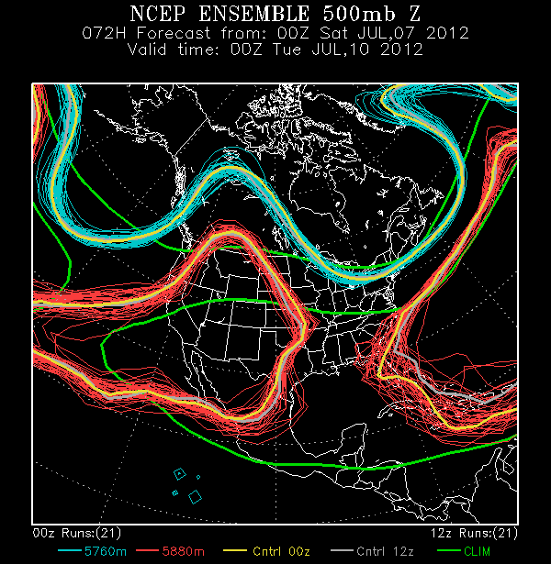
Weather system is chaotic.
Chaotic dynamical system has intrinsic limit to predictability.

Slide 13
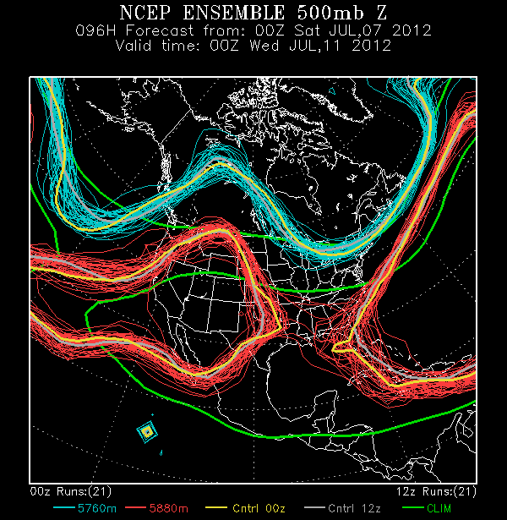
Weather system is chaotic.
Chaotic dynamical system has intrinsic limit to predictability.

Slide 14
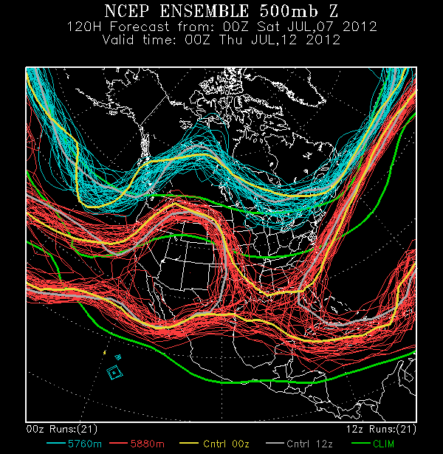
Weather system is chaotic.
Chaotic dynamical system has intrinsic limit to predictability.

Slide 15
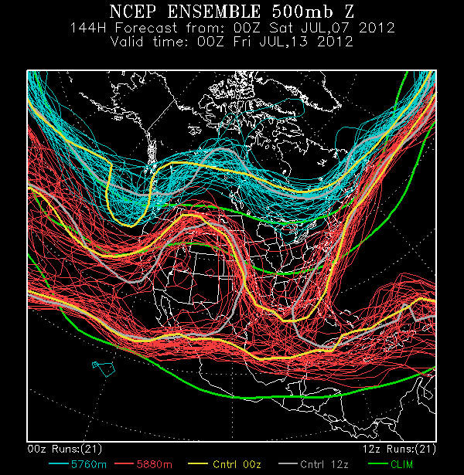
Weather system is chaotic.
Chaotic dynamical system has intrinsic limit to predictability.

Slide 16
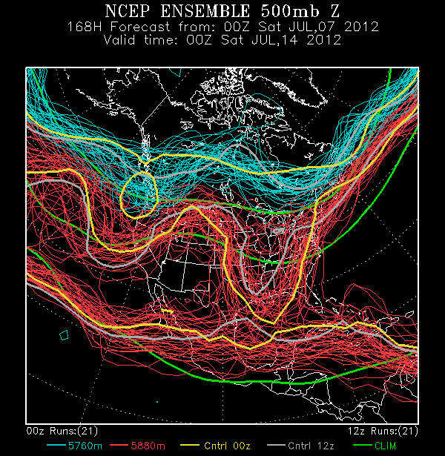
Weather system is chaotic.
Chaotic dynamical system has intrinsic limit to predictability.

Slide 17
What can we do? (frontier research)
Obtain more accurate initial conditions
  More observations
  Better data assimilation methods
Understand the error growth
  Better understand the dynamics and physics
Predict the predictability
  Let users know how (un)certain the forecasts.

Slide 18

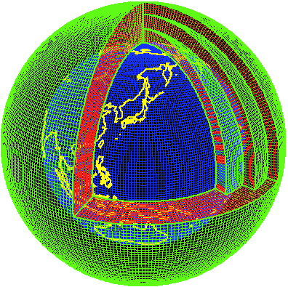

Data Assimilation
Observations
Numerical models
Data Assimilation
©Vaisala
Data assimilation best combines observations and a model, and brings synergy.

Slide 19
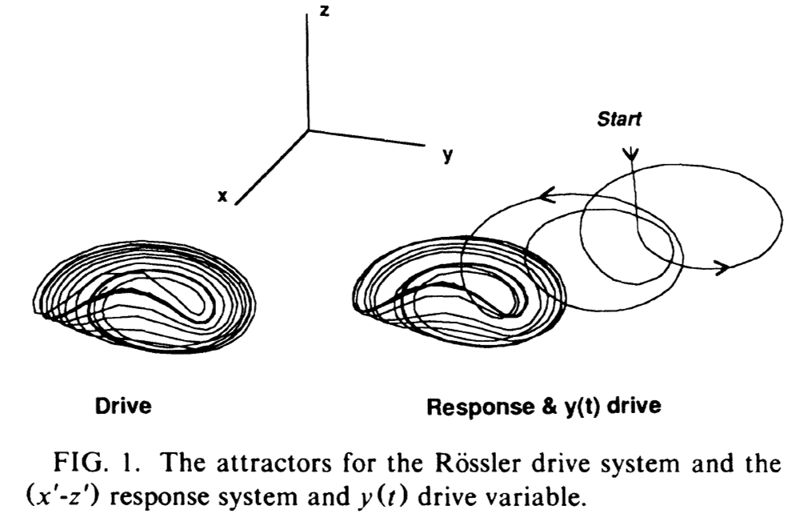
Chaos synchronization
Master (drive) system
Slave (response) system
Observation
Transferring information
Nature
Simulation

Slide 20
Chaos synchronization problem
We would like to synchronize the model simulations with reality.
  (Questions:)
  Under what conditions do they synchronize?
  How easy/difficult is the synchronization?
(Answer:) Synchronization depends on the coupling strength and system’s instabilities.
  Observing network (quality and quantity of transferring information)
  Accuracy of the simulation model
  Optimality of the data assimilation method

Slide 21
Numerical Weather Prediction
Forecast
Forecast
Model Simulation
Analysis
Analysis
Observation
Observation
Analysis
True atmosphere (Unknown)
time

Slide 22
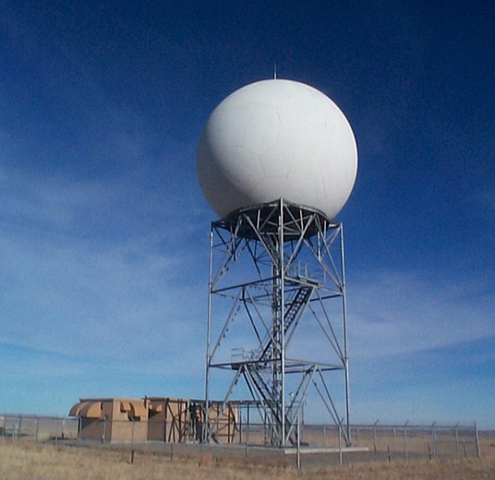


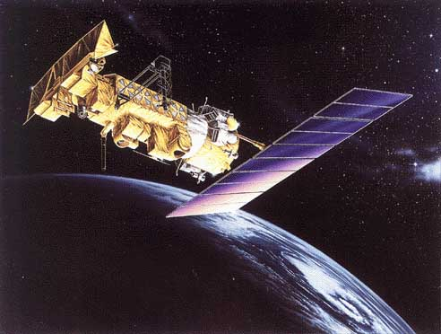


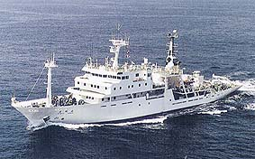
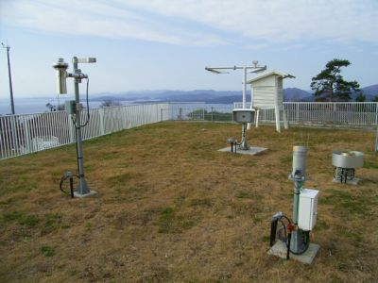
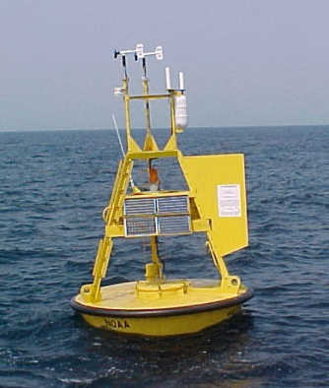
Global Observing System
Radar
Aircraft
Satellite
Weather balloon
Ship
Buoy
Surface station

Slide 23
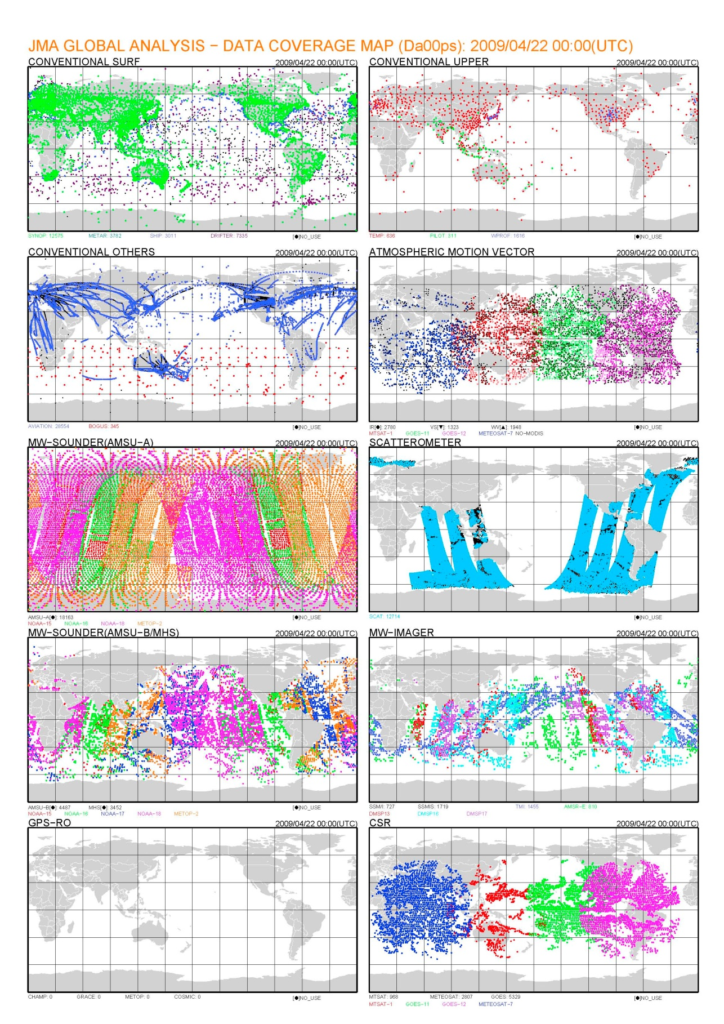
Collecting the data
World’s effort! (no border in the atmosphere)

Slide 24
Collecting the data

Slide 25
Data Assimilation (DA)
Observations
Numerical models
Data Assimilation
©Vaisala
Data assimilation best combines observations and a model, and brings synergy.

Slide 26
Data Assimilation
DA corrects forecast fields to fit better with observations.
DA produces the best estimate of the current atmospheric state, which is used as the initial condition for NWP.
Geopotential height at upper atmosphere is basically parallel to winds.

Slide 27
Kalman Filter (KF)
Analysis w/ errors
OBS w/ errors
Direct application to high-dimensional systems is prohibitive.
Analysis w/ errors
FCST w/ errors
T=t0
T=t1

Slide 28
Ensemble Kalman Filter (EnKF)
Obs.
Analysis ensemble mean
An approximation to KF with ensemble representations
Analysis w/ errors
FCST ensemble mean
T=t0
T=t1
T=t2

Slide 29
LETKF (Local Ensemble Transform Kalman Filter)
Analysis is given by a linear combination of forecast ensemble:
Ensemble Transform Matrix
(ETKF, Bishop et al. 2001; LETKF, Hunt et al. 2007)
ensemble mean update
uncertainty update
Analysis error covariance in the ensemble subspace

Slide 30
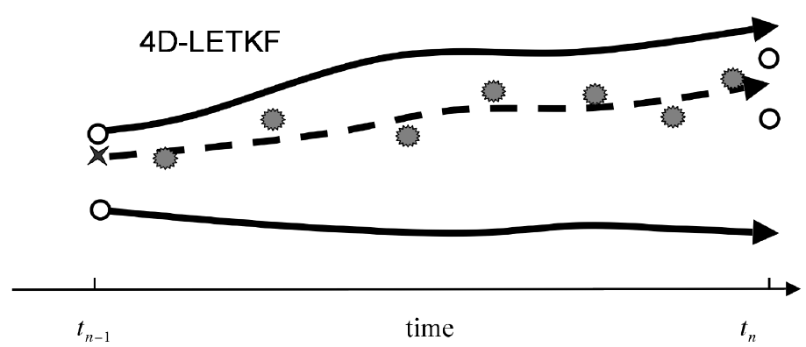
4D-LETKF (Ensemble Kalman Smoother)
○
○
○
★
○
t_{n-1}
t_{n}
4D-LETKF can treat observations within a time window.
  Including future observations (smoother)
  Better treating frequent observations (satellites, radars, etc.)

Slide 31
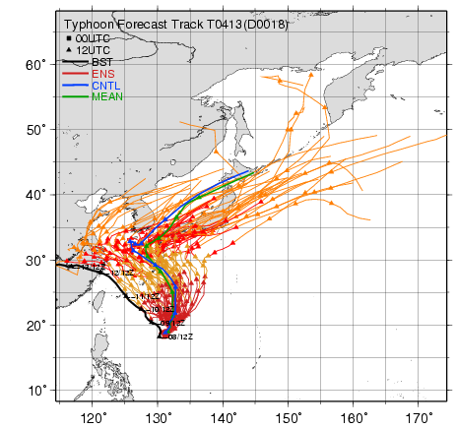
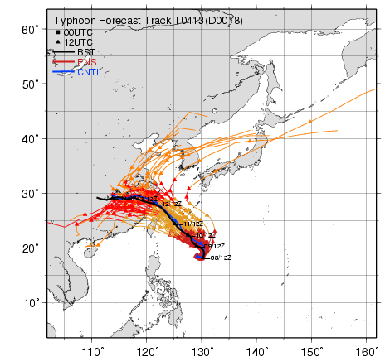
DA has an impact.
SV w/ 4D-Var
LETKF
JMA operational system
under development
FCST
FCST
OBS
OBS
Miyoshi and Sato (2007)
Using the same NWP model and observations.
DA matters!

Slide 32
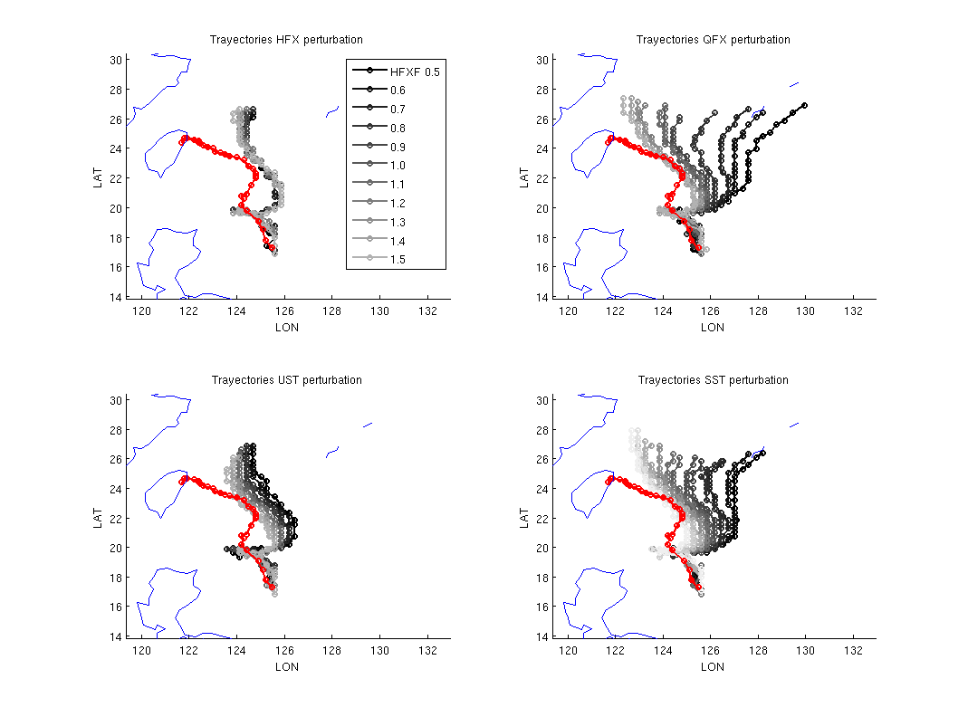
DA can find optimal model parameters.
Sensitivity to the model parameters (a real TC case)
Ruiz and Miyoshi (2012)
Less sensitive
More sensitive
Find optimal parameters using observations
Sensible heat flux parameter
Latent heat flux parameter

Slide 33
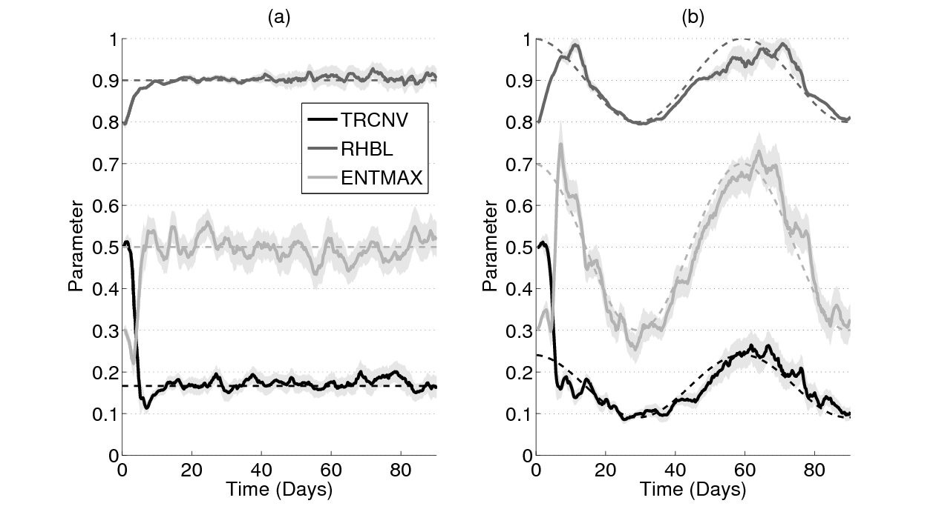
DA can find optimal model parameters.
Sensitivity to the model parameters (a real TC case)
Ruiz and Miyoshi (2012)
Less sensitive
More sensitive
Find optimal parameters using observations
Sensible heat flux parameter
Latent heat flux parameter
Parameter estimation with an EnKF
(idealized experiments)
: true value
Time-varying parameters
Bad initial values
Accurate and stable estimates after spin-up

Slide 34
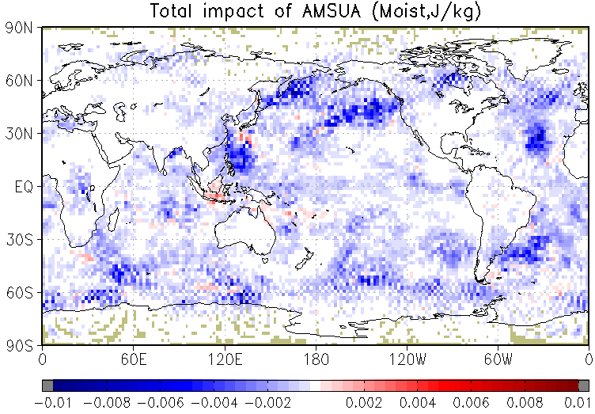
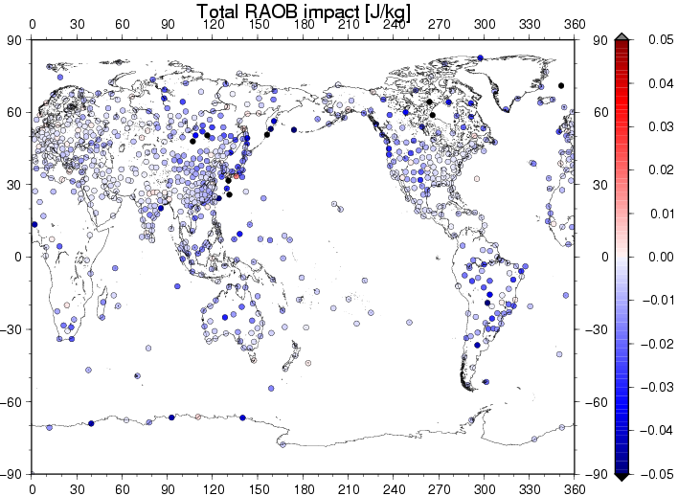
DA gives feedback about observations.
Estimated impact of observations
(from NCEP Global Forecasting System, Y. Ota 2012)
AMSU-A (Satellite)
RAOB (In-situ)
Degrading
Improving
Improving
Degrading
(Courtesy of Y. Ota)
two-way

Slide 35
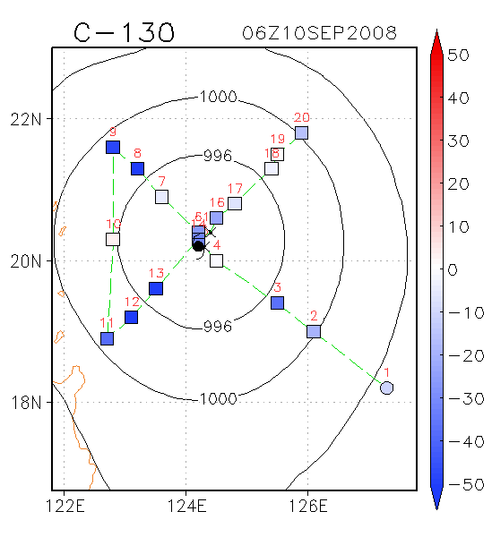
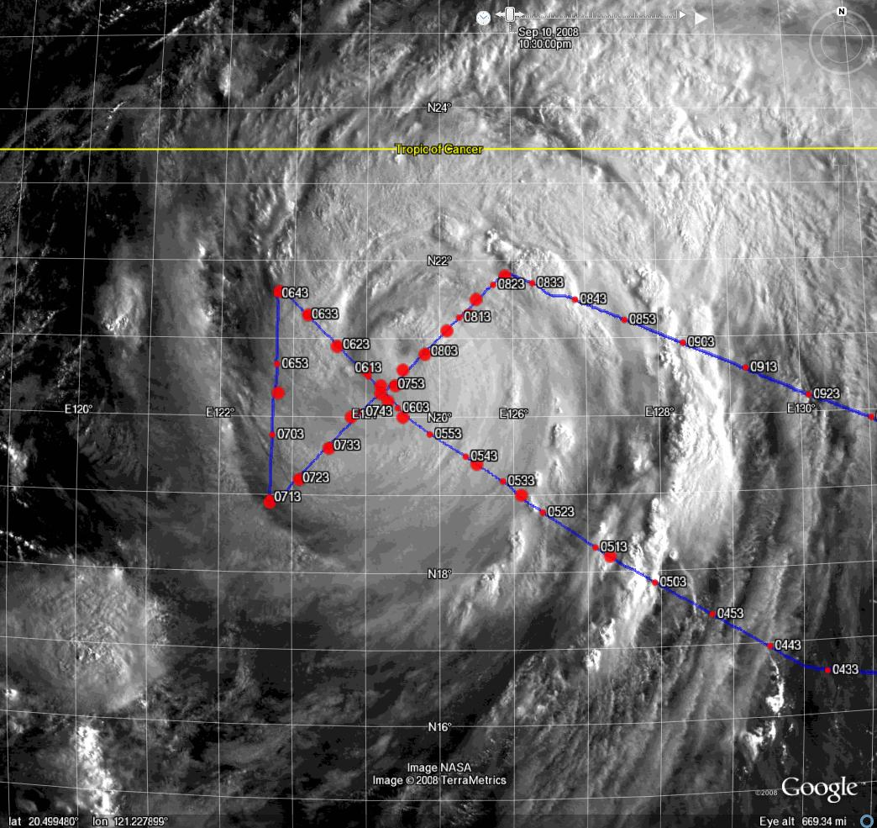
Impact of WC-130J dropsondes
Kunii and Miyoshi (2012)
Degrading
Improving

Slide 36
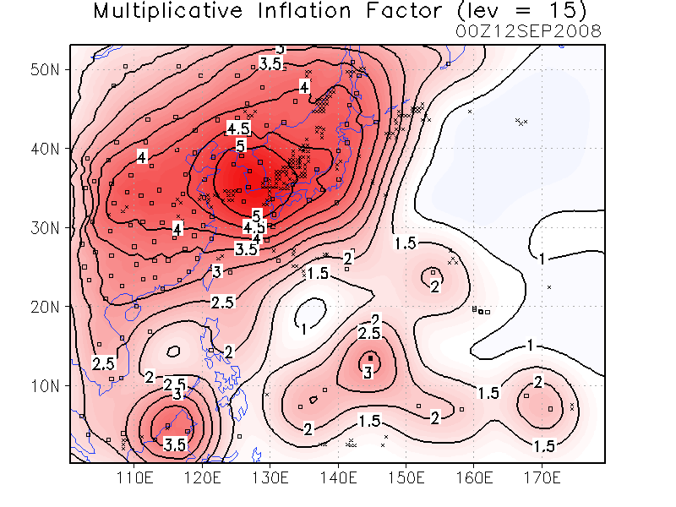
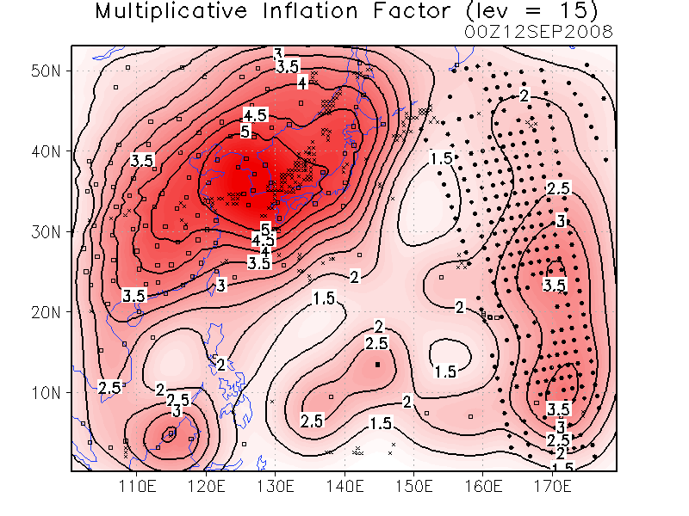
Assimilation of satellite data
CTRL | AIRS: Atmospheric Infrared Sounder
Conventional (NCEP PREPBUFR) | Conv. + AIRS retrievals (AIRX2RET - T, q)
Larger inflation is estimated due to the AIRS data.
Adaptive inflation method was newly developed (Miyoshi 2011).

Slide 37
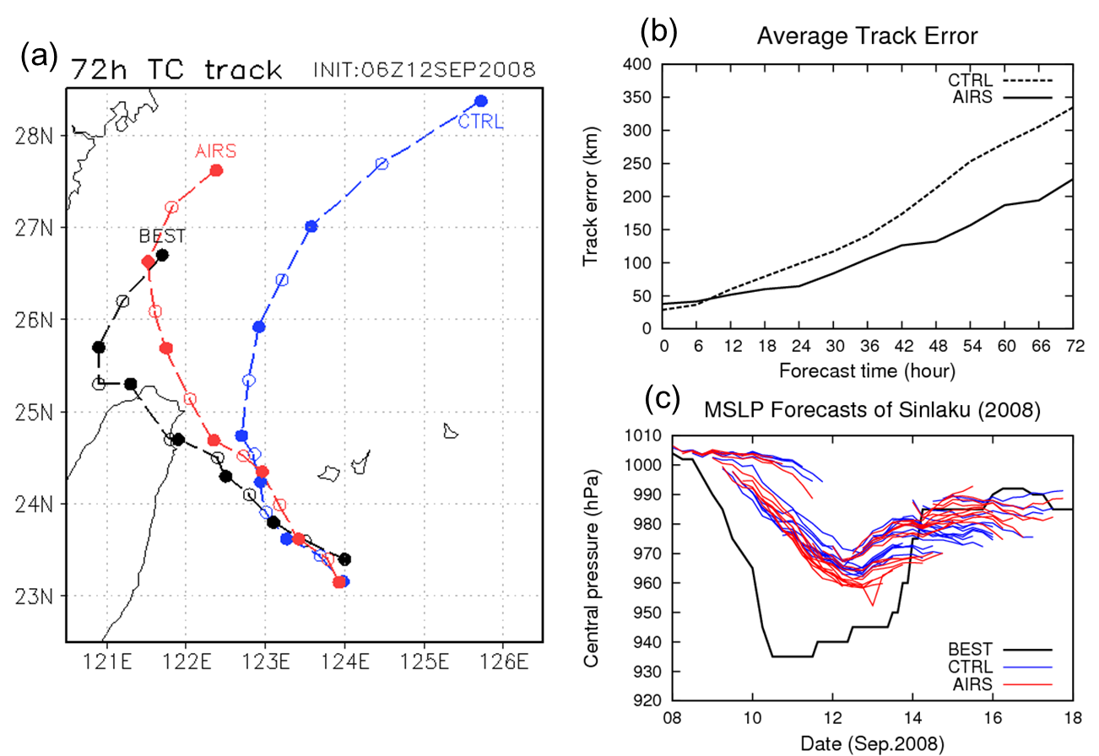
AIRS impact on TC forecasts
~28 samples
Too deep to resolve by 60-km WRF
TC track forecasts for Typhoon Sinlaku (2008) were significantly better, particularly in longer leads.

Slide 38
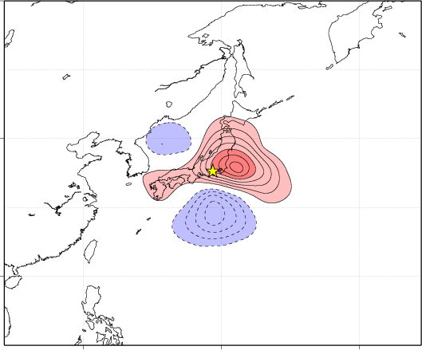
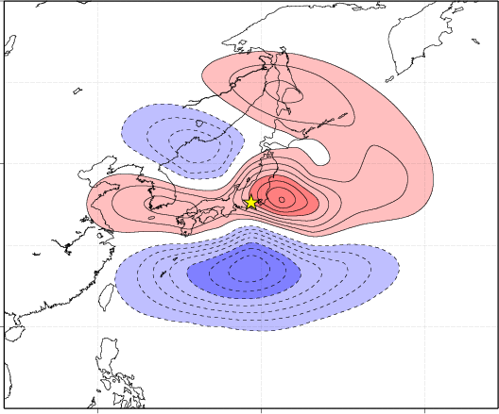
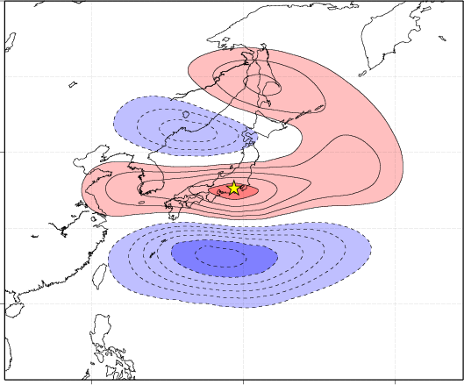
A new idea on multiscale treatment
Smaller scale
Observation
Multiscale analysis
Larger scale
Observations were used more effectively, and analysis accuracy was much improved.

Slide 39
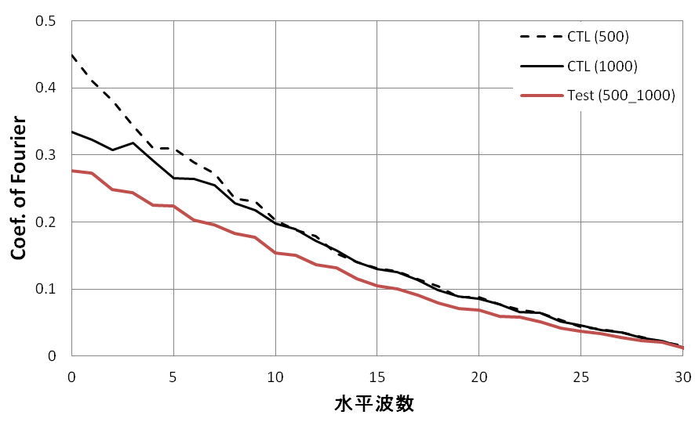
Improvements at all scales
Successfully reducing the errors at almost all scales.
1-month average global analysis error power spectrum
500-km localization standard LETKF
1000-km localization standard LETKF
500-1000-km dual-localization LETKF
Wave number

Slide 40
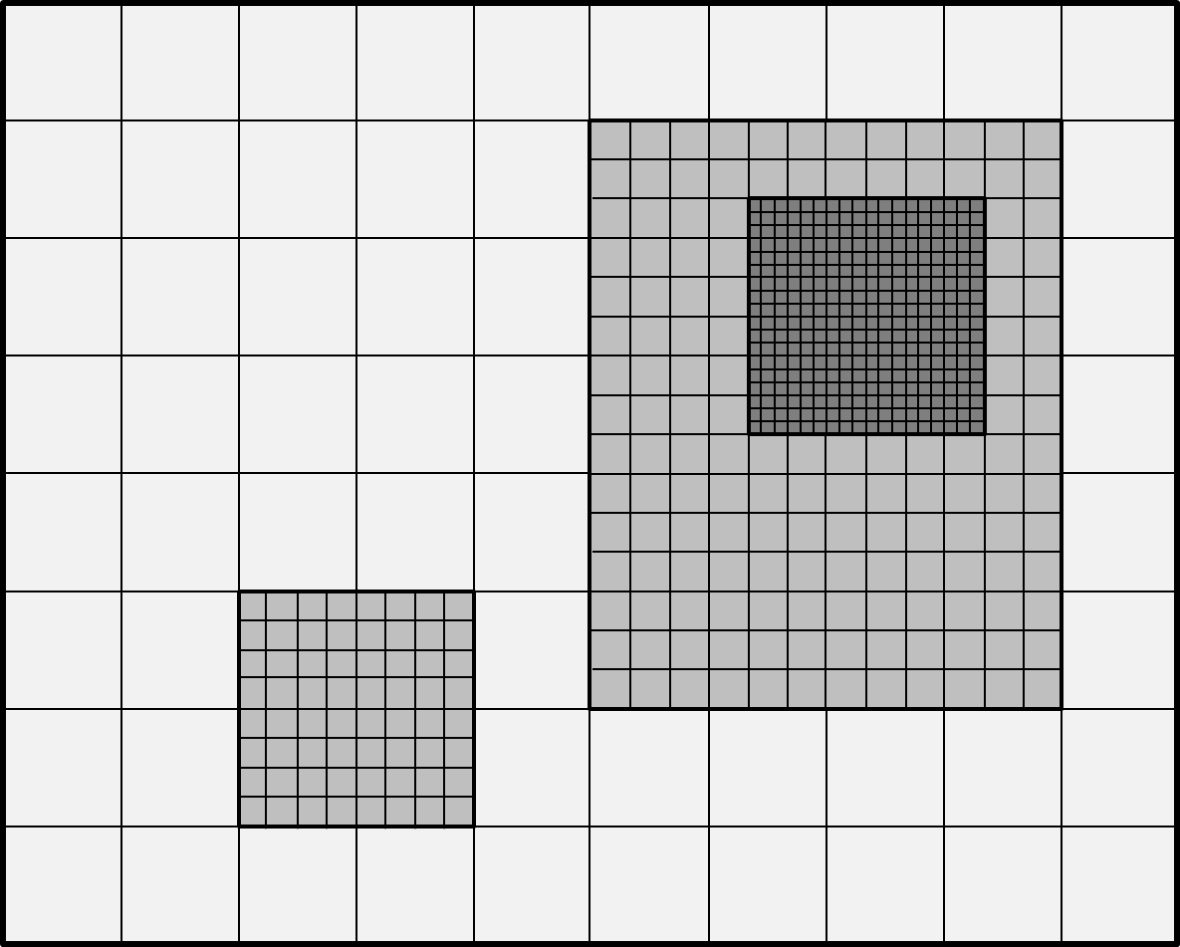
Challenges with higher resolutions
Algorithmic design with arbitrary grid structures

Slide 41
Data Assimilation (DA)
Observations
Numerical models
Data Assimilation
©Vaisala
Data assimilation best combines observations and a model, and brings synergy.
Tackling predictability of chaotic dynamical systems,
Model parameter optimization, observing network optimization, etc.

Slide 42
Expanding collaborations
AFES
JMA GSM
Atmosphere
CFES
JMA MSM
Ocean
CPTEC Brazil
WRF-ROMS
WRF
OFES
LETKF
GFS
ROMS
SPEEDY CO2
MOM
CAM
JAMSTEC Chem
Mars GCM
:Existing
U.Tokyo Aerosol
Chemistry
:Possible future expansion
MRI Chem

Slide 43
I would welcome new collaborations!
AFES
JMA GSM
Atmosphere
CFES
JMA MSM
Ocean
CPTEC Brazil
WRF-ROMS
WRF
OFES
GFS
Thank you very much for your kind attention!!
ROMS
SPEEDY CO2
MOM
CAM
JAMSTEC Chem
Mars GCM
:Existing
U.Tokyo Aerosol
Chemistry
:Possible future expansion
MRI Chem

