Slide 1

Challenges and Solutions in Large-Scale Computing Systems
Naoya Maruyama
Aug 17, 2012

Slide 2
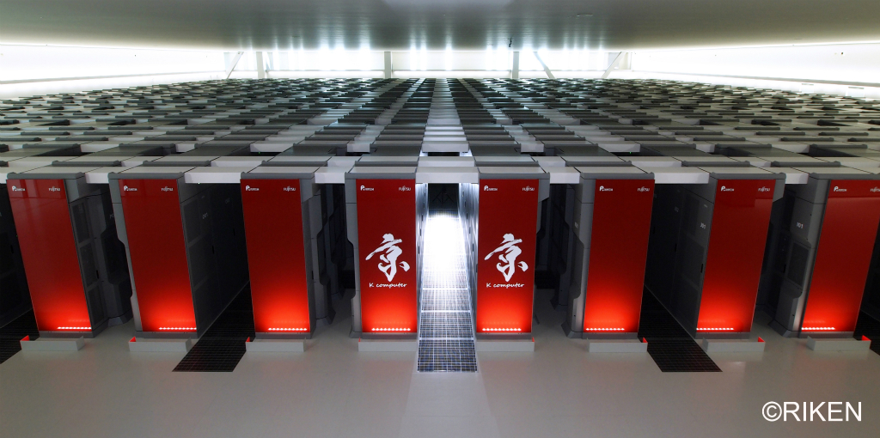


Slide 3
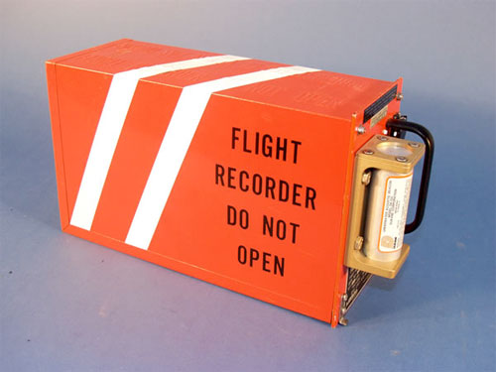

Slide 5
x 80000?

Slide 6

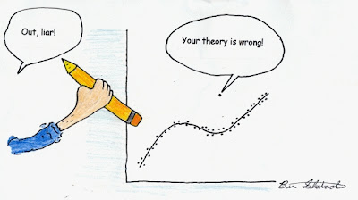
Correct operations almost always
Occasional misbehavior

Slide 7
Hypothesis: Debugging by
Outlier Detection
trace
Suspect Score
Contribution
trace
Func
trace
Outlier!
f₁
f₂
f₃
f₄
f₅
proc
trace
proc
trace
proc
proc
proc
trace
trace
proc
proc
Data Collection
Finding Anomalous
Processes
Finding Anomalous
Functions
Joint work with Mirgorodskiy and Miller [SC’06][IPDPS’08]

Slide 8
Data Collection
…
ENTER func_addr 0x819967c timestamp 12131002746163258
LEAVE func_addr 0x819967c timestamp 12131002746163936
ENTER func_addr 0x819967c timestamp 12131002746164571
LEAVE func_addr 0x819967c timestamp 12131002746165197
ENTER func_addr 0x819967c timestamp 12131002746165828
LEAVE func_addr 0x819967c timestamp 12131002746166395
LEAVE func_addr 0x80de590 timestamp 12131002746166938
ENTER func_addr 0x819967c timestamp 12131002746167573
…
Appends an entry at each call and return
  addresses, timestamps
Allows function-level analysis
  e.g., “Function X is likely anomalous.”
Allows context-sensitive analysis
  e.g., “Function X is anomalous only when called from function Y.”
Notes:
This diagram illustrates data we collect from each process. It’s a function call trace. Each line represents a function call or return with its timestamp. Since we record all function calls and returns, we can achieve function-level localization granularity. For example, we may be able to say “Function X is likely anomalous.” or “Function X is anomalous only when called from function Y.”

Slide 9
Defining the Distance Metric
Say, there are only two functions, func_A and func_B, and tree traces, trace_X, trace_Y, trace_Z
Normalized time spent in each function
 | func_A | func_B
trace_X | 0.5 | 0.5
trace_Y | 0.6 | 0.4
trace_Z | 0 | 1.0
func_B
1.0
trace_Z
0.5
trace_X
trace_Y
0.4
0
func_A
0.5
0.6

Slide 10
Defining the Suspect Score
σ(g)
g
σ(h)
h
Common behavior = normal
Suspect score: σ(h) = distance to nearest neighbor
  Report process with the highest σ to the analyst
  h is in the big mass, σ(h) is low, h is normal
  g is a single outlier, σ(g) is high, g is an anomaly
What if there is more than one anomaly?

Slide 11
Defining the Suspect Score
σ_{k}(g)
g
h
Computing the score using k=2
Suspect score: σ_{k}(h) = distance to the k^{th} neighbor
  Exclude (k-1) closest neighbors
  Sensitivity study: k = NumProcesses/4 works well
Represents distance to the “big mass”:
  h is in the big mass, k^{th} neighbor is close, σ_{k}(h) is low
  g is an outlier, k^{th} neighbor is far, σ_{k}(g) is high

Slide 12
Defining the Suspect Score
σ_{k}(g)
g
h
Anomalous means unusual, but unusual does not always mean anomalous!
  E.g., MPI master is different from all workers
  Would be reported as an anomaly (false positive)
Distinguish false positives from true anomalies:
  With knowledge of system internals – manual effort
  With previous execution history – can be automated

Slide 13
Defining the Suspect Score
g
h
n
Add traces from known-normal previous run
  One-class classification
Suspect score σ_{k}(h) = distance to the k^{th} trial neighbor or the 1st known-normal neighbor
Distance to the big mass or known-normal behavior
  h is in the big mass, k^{th} neighbor is close, σ_{k}(h) is low
  g is an outlier, normal node n is close, σ_{k}(g) is low

Slide 14
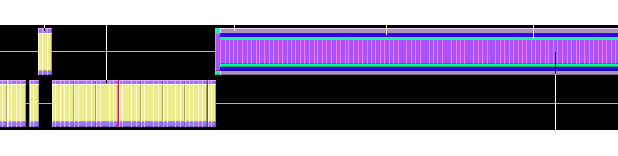
Case Study: Debugging Non-Deterministic Misbehavior
output_job_status
score_write_short
score_write
__libc_write
SCore cluster middle running on a 128-node cluster
Occasional hang up, requiring system restart
Result
  Call chain with the highest contribution to the suspect score: (output_job_status -> score_write_short -> score_write -> __libc_write)
    Tries to output a log message to the scbcast process
  Writes to the scbcast process kept blocking for 10 minutes
    Scbcast stopped reading data from its socket – bug!
    Scored did not handle it well (spun in an infinite loop) – bug!

Slide 15
Log file analysis
Slides courtesy of Ana Gainaru
Log files give useful information about
hardware, application, user actions
    Logs have a huge size: million of messages per day
    Different systems represent messages in different ways (e.g. header and message with red)
  Changes in the normal behavior of a message type could indicate a problem
  We can analyze log files for:
  • Optimal checkpoint interval computation
  • Detection of abnormal behaviors
Blue Gene logs
- 1119339918 R36-M1-NE-C:J11-U11 RAS KERNEL FATAL L3 ecc control register: 00000000
Cray logs
Jul 8 02:43:34 nid00011 kernel: Lustre: haven't heard from client * in * seconds.

Slide 16
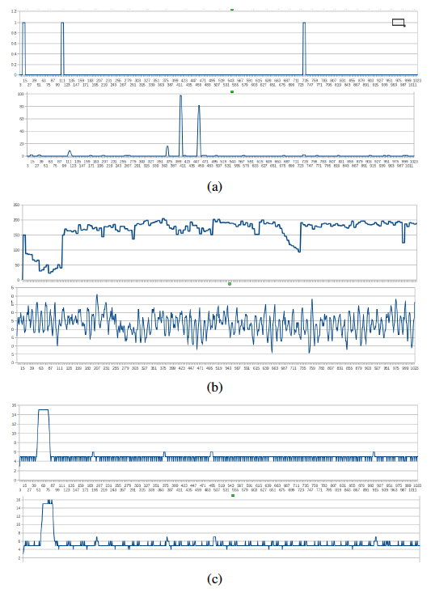
Signal analysis
Slides courtesy of Ana Gainaru
Can be used to identify the abnormal areas; easy to visualize as well
Silent signal characteristic of error events. PBS errors
Noise signal
typically Warning messages: Memory errors corrected by ECC
Periodic signals
daemons, monitoring

Slide 17
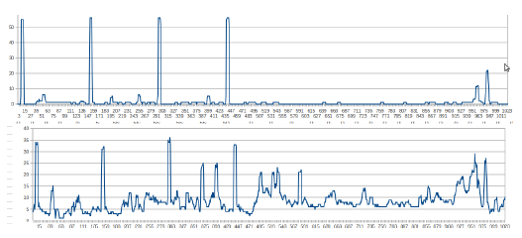
Event correlations
Slides courtesy of Ana Gainaru
Event correlations
  Rule based correlations with data mining
    If (event1, 2,..n happen) => event n+1 will happen
  Using signal analysis
    Event's 1 signal is correlated to event's 2 signal with a time lag and a probability

Slide 18
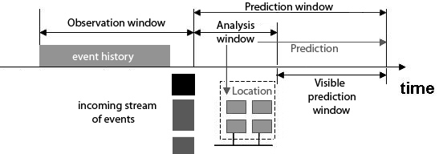
Prediction process
Slides courtesy of Ana Gainaru
Uses past log entries to determine active correlations
Gets location for future failures
Visible prediction window is used for fault avoidance actions

Slide 19
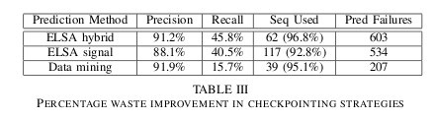
Results
Slides courtesy of Ana Gainaru
First line: signal analysis with data mining
Second: just signal analysis
Third: just data mining
Around 30% of failures allow avoidance techniques
  e.g. checkpoint the application before the fault occurs

Slide 20
Checkpoint/Restart
[Sato et al., SC’12]
Checkpoint: Periodically take a snapshot(checkpoint) of an application state to a reliable parallel file system (PFS)
Restart: On a failure, restart the execution from the last checkpoint
failure
checkpoint
checkpoint
checkpoint
Problem: Checkpointing overhead

Slide 21
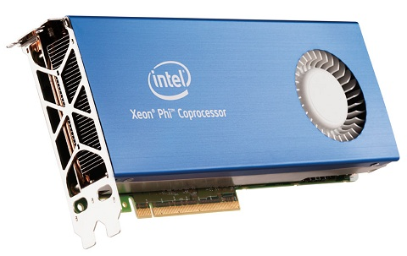
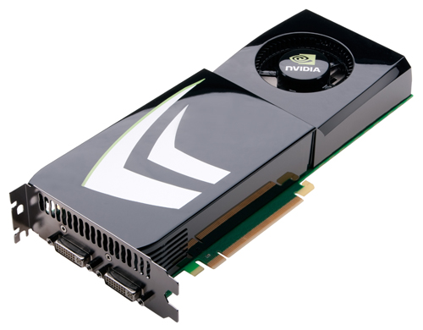
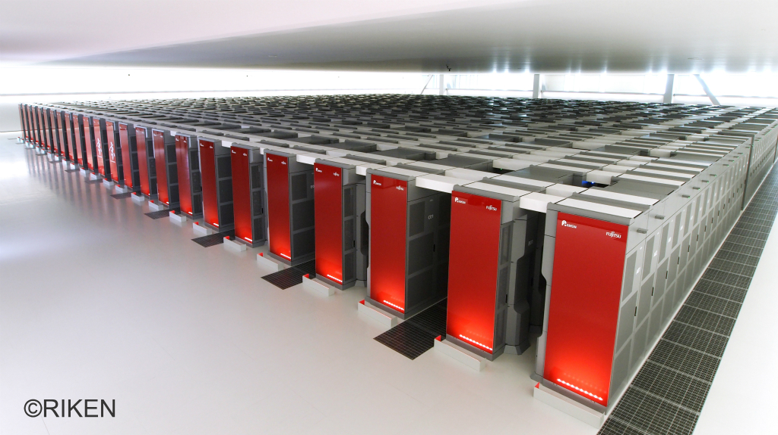
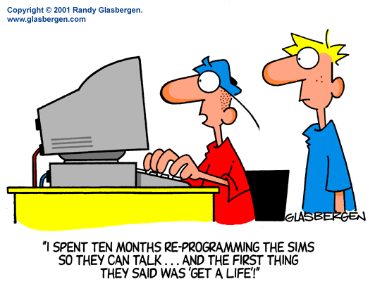
Notes:
New x means to rewrite applications to some extent.
Some effort toward convergence of “X”, yet …
Let me illustrate this trend using stencil computations as an example.

Slide 22
Observation: Stencil Computation
Notes:
In this talk, I’m gonna focus on one very common computation pattern, stencil computation. for example, we have multidimensional grids and for each grid element we do some computations using neighbor elements. While this pattern of computation is very simple, it is highly valuable pattern in various fields of computational sciences, such as seismic simualtions, astrophysics, and also weather forecasting.

Slide 23
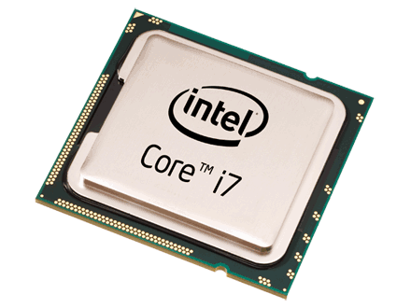
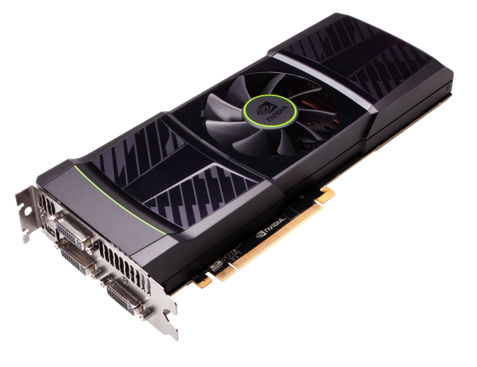
Using GPU
CPU Thread
GPU Threads

Slide 24
GPU Implementation
Notes:
The way stencil computation is implemented would typically look like as follows. First we decompose a given domain into evenly divided subregions, and assign one thread block to each subregion, and each thread computes part of the elements in a subregion.

Slide 25
GPU Cluster Implementation
MPI Process
MPI Process
MPI Process
MPI Process
Notes:
This hierarchical programming model is actually very effective in fine tuning the data locality available in computations. But as you could imagine, it’s a very tedious and error prone programming model. And furthermore this is not portable. Each accelerator has different architectural properties, so even using common languages like OpenCL, it doesn’t allows you to write a portable programs in terms of performance.

Slide 26
Physis (Φύσις) Framework
[Maruyama et al.]
Physis (φύσις) is a Greek theological, philosophical, and scientific term usually translated into English as "nature.“ (Wikipedia:Physis)
Stencil DSL
Declarative
Portable
Global-view
C-based
void diffusion(int x, int y, int z,
PSGrid3DFloat g1, PSGrid3DFloat g2) {
float v = PSGridGet(g1,x,y,z)
+PSGridGet(g1,x-1,y,z)+PSGridGet(g1,x+1,y,z)
+PSGridGet(g1,x,y-1,z)+PSGridGet(g1,x,y+1,z)
+PSGridGet(g1,x,y,z-1)+PSGridGet(g1,x,y,z+1);
PSGridEmit(g2,v/7.0);
}
C
DSL Compiler
Target-specific
code generation
and optimizations
Automatic parallelization
C+MPI
Physis
CUDA
CUDA+MPI
OpenMP
OpenCL
Notes:
The Physis framework is our approach to providing and realizing high-level abstractions for stencil computations.
The main components of this framework are a domain specific language for stencil computations and its compiler. For a given problem, the DSL allows for declarative and portable programming with global-view memory model. And it is automatically parallelized into programs for various parallel platforms, including GPU clusters.

Slide 27
Writing Stencils
Stencil Kernel
  C functions describing a single flow of scalar execution on one grid element
  Executed over specified rectangular domains
3-D stencils must have 3 const integer parameters first
void diffusion(const int x, const int y, const int z,
PSGrid3DFloat g1, PSGrid3DFloat g2,
float t) {
float v = PSGridGet(g1,x,y,z)
+PSGridGet(g1,x-1,y,z)+PSGridGet(g1,x+1,y,z)
+PSGridGet(g1,x,y-1,z)+PSGridGet(g1,x,y+1,z)
+PSGridGet(g1,x,y,z-1)+PSGridGet(g1,x,y,z+1);
PSGridEmit(g2,v/7.0*t);
}
Issues a write to grid g2
Offset must be constant
Notes:
Stencil operations can be written as standard C functions with some restrictions.

Slide 28
Implementation
DSL source-to-source translators + architecture-specific runtimes
  Sequential CPU, MPI, single GPU with CUDA, multi-GPU with MPI+CUDA
DSL translator
  Translate intrinsincs calls to RT API calls
  Generate GPU kernels with boundary exchanges based on static analysis
  Using the ROSE compiler framework (LLNL)
Runtime
  Provides a shared memory-like interface for multidimensional grids over distributed CPU/GPU memory

Slide 29
Example: 7-point Stencil GPU Code
__device__ void kernel(const int x,const int y,const int z,__PSGrid3DFloatDev *g,
__PSGrid3DFloatDev *g2)
{
float v = (((((( *__PSGridGetAddrNoHaloFloat3D(g,x,y,z) +
*__PSGridGetAddrFloat3D_0_fw(g,(x + 1),y,z)) + *__PSGridGetAddrFloat3D_0_bw(g,(x - 1),y,z)) +
*__PSGridGetAddrFloat3D_1_fw(g,x,(y + 1),z)) + *__PSGridGetAddrFloat3D_1_bw(g,x,(y - 1),z)) +
*__PSGridGetAddrFloat3D_2_bw(g,x,y,(z - 1))) + *__PSGridGetAddrFloat3D_2_fw(g,x,y,(z + 1)));
*__PSGridEmitAddrFloat3D(g2,x,y,z) = v;
}
__global__ void __PSStencilRun_kernel(int offset0,int offset1,__PSDomain dom,
__PSGrid3DFloatDev g,__PSGrid3DFloatDev g2)
{
int x = blockIdx.x * blockDim.x + threadIdx.x + offset0;
int y = blockIdx.y * blockDim.y + threadIdx.y + offset1;
if (x < dom.local_min[0] || x >= dom.local_max[0] || (y < dom.local_min[1] || y >= dom.local_max[1]))
return ;
int z;
for (z = dom.local_min[2]; z < dom.local_max[2]; ++z) {
kernel(x,y,z,&g,&g2);
}
}

Slide 30
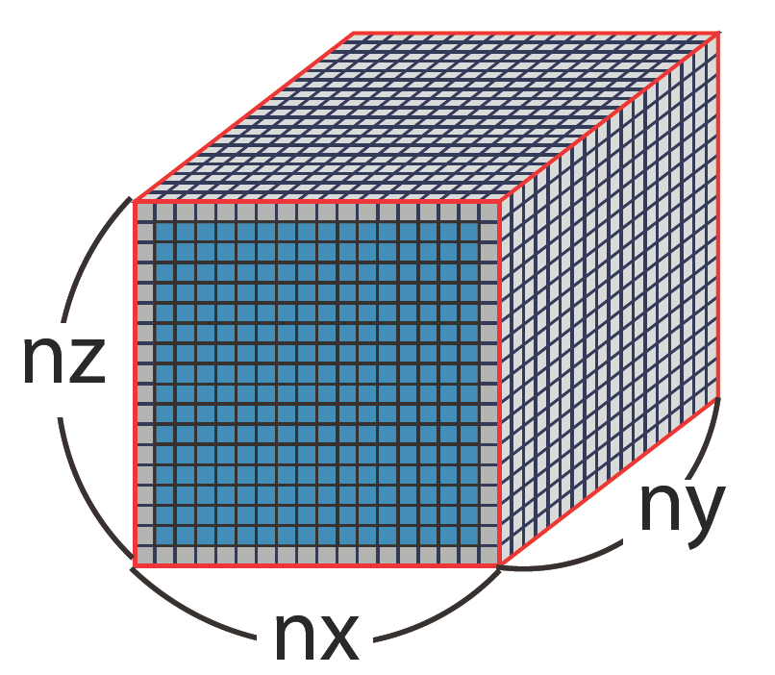
Optimization： Overlapped Computation and Communication
Inner points
1. Copy boundaries from GPU to CPU for non-unit stride cases
2. Computes interior points
3. Boundary exchanges with neighbors
Boundary
4. Computes boundaries
Time

Slide 31
Optimization Example: 7-Point Stencil CPU Code
Computing Interior Points
for (i = 0; i < iter; ++i) {
__PSStencilRun_kernel_interior<<<s0_grid_dim,block_dim,0, stream_interior>>>
(__PSGetLocalOffset(0),__PSGetLocalOffset(1),__PSDomainShrink(&s0 -> dom,1),
*((__PSGrid3DFloatDev *)(__PSGridGetDev(s0 -> g))), *((__PSGrid3DFloatDev *)(__PSGridGetDev(s0 -> g2))));
int fw_width[3] = {1L, 1L, 1L};
int bw_width[3] = {1L, 1L, 1L};
__PSLoadNeighbor(s0 -> g,fw_width,bw_width,0,i > 0,1);
__PSStencilRun_kernel_boundary_1_bw<<<1,(dim3(1,128,4)),0,
stream_boundary_kernel[0]>>>(__PSDomainGetBoundary(&s0 -> dom,0,0,1,5,0),
*((__PSGrid3DFloatDev *)(__PSGridGetDev(s0 -> g))), *((__PSGrid3DFloatDev *)(__PSGridGetDev(s0 -> g2))));
__PSStencilRun_kernel_boundary_1_bw<<<1,(dim3(1,128,4)),0,
stream_boundary_kernel[1]>>>(__PSDomainGetBoundary(&s0 -> dom,0,0,1,5,1),
*((__PSGrid3DFloatDev *)(__PSGridGetDev(s0 -> g))), *((__PSGrid3DFloatDev *)(__PSGridGetDev(s0 -> g2))));
…
__PSStencilRun_kernel_boundary_2_fw<<<1,(dim3(128,1,4)),0,
stream_boundary_kernel[11]>>>(__PSDomainGetBoundary(&s0 -> dom,1,1,1,1,0),
*((__PSGrid3DFloatDev *)(__PSGridGetDev(s0 -> g))), *((__PSGrid3DFloatDev *)(__PSGridGetDev(s0 -> g2))));
cudaThreadSynchronize();
}
cudaThreadSynchronize();
}
Boundary Exchange
Computing Boundary Planes Concurrently

Slide 32
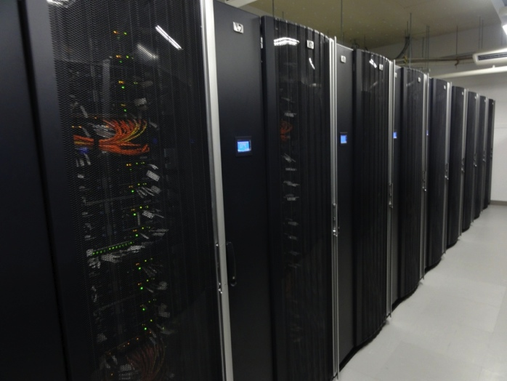
Evaluation
Performance and productivity
Sample code
  7-point diffusion kernel (#stencil: 1)
  Jacobi kernel from Himeno benchmark (#stencil: 1)
  Seismic simulation (#stencil: 15)
Platform
  Tsubame 2.0
    Node: Westmere-EP 2.9GHz x 2
    + M2050 x 3
    Dual Infiniband QDR with full
    bisection BW fat tree

Slide 33
Himeno Strong Scaling
Problem size XL (1024x1024x512)

Slide 34
Acknowledgments
Alex Mirgorodskiy
Barton Miller
Leonardo Bautista Gomez
Kento Sato
Satoshi Matsuoka
Franck Cappello
Ana Gainaru

